Slide 1
STUDENT NAME: Akshaya.V S
REGISTER NO: 312214979
DEPARTMENT: Commerce
COLLEGE: Soka Ikeda college
Employee Data Analysis using Excel

Slide 2

PROJECT TITLE:
Employee Performance Analysis using Excel

Slide 3

AGENDA:
Problem Statement
Project Overview
End Users
Our Solution and Proposition
Dataset Description
Modelling Approach
Results and Discussion
Conclusion

Slide 4
Problem statement:
🔸Promotions and Compensation: Identifying high-performing employees who deserve recognition and rewards.
🔸Training and Development: Identifying areas where employees need additional training or support to improve their performance.
🔸 Team Formation: Assigning employees to teams based on their skills and strengths.

Slide 5
Project overview:
Make data-driven decisions regarding promotions, compensation, and training.Identify areas for improvement and provide targeted development opportunities. Foster a culture of performance excellence and employee engagement.Align individual performance with organizational goals and objectives.Remember to customize your analysis based on your organization's specific needs and goals.

Slide 6
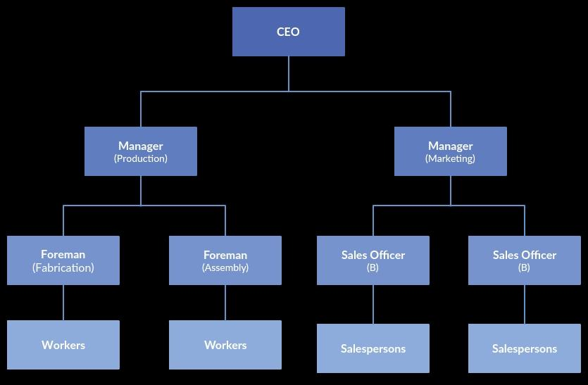

Who are the end users?
Employees
Employers
Manager
Human resource (HR)
Executive leardership
stakeholders
They’re all the end users…!

Slide 7

Our solution and its value proposition:
1.Filtering : Removin missing values
2.IFS Formula : Finding the employee performance
3.Pivot Tables : Analysing the data
4.Graphs : Analysing the data

Slide 8

Dataset description:
*Employee – Kaggle
*26 – features
*9 – features
*Name - Alphabatical
*Performance level - Numerical value
*Employee type - Alphabatical
*Gender - Male/Female
*Employee rating - Numerical value
*Business unit - Alphabatical

Slide 9

=IFS(Z8>=5,”VERY HIGH”,Z8>=4,”HIGH”,Z8>=3,”MEDIUM,”TRUE,”LOW”
This formula is used for Finding performance level….!
THE "WOW" IN OUR SOLUTION:

Slide 10

Modelling:
Data collection:
1.From kaggle dashboard
2.Formating the dataset
Summary:
1.Grouping & aggregating data
2.Identifying trends & patterns
Feature collection:
1. Data entry and management 2.Calculations and metrics
Visualization:
1.Prepared & selected the data
2.Customised the chart:
-Label
-Explode slices
-Colour & legend
Data cleaning:
1.Conditional formatting – missing values
2.Filter outing – removing blanks
Performance level:
1.High-exceeds expectation
2.Low-falls short in expectation

Slide 11
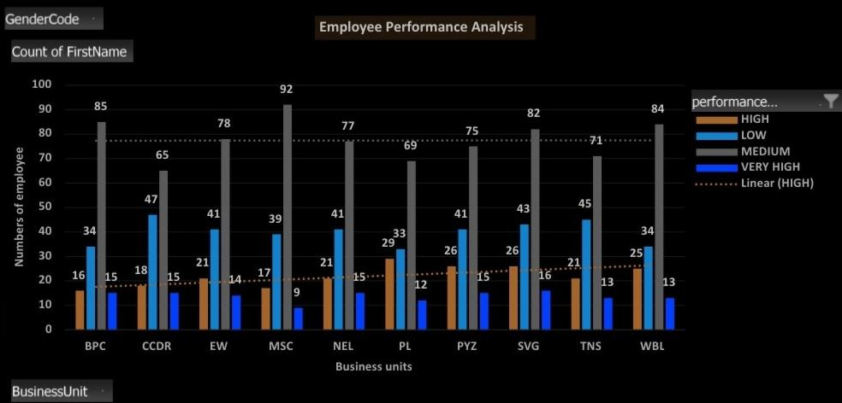
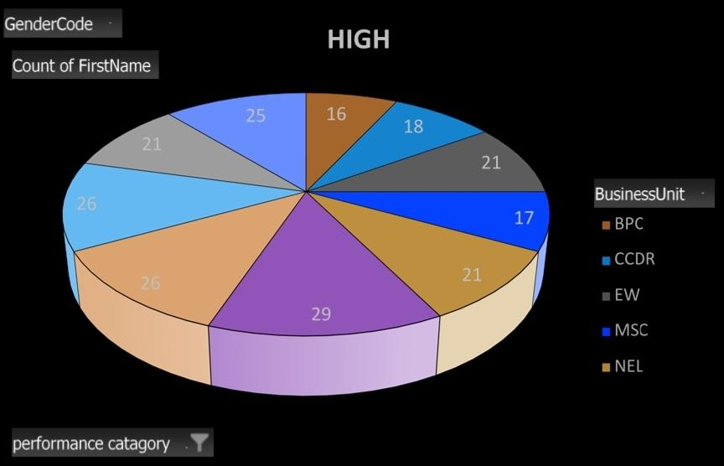
Results:
These are the results of the project...!

Slide 12
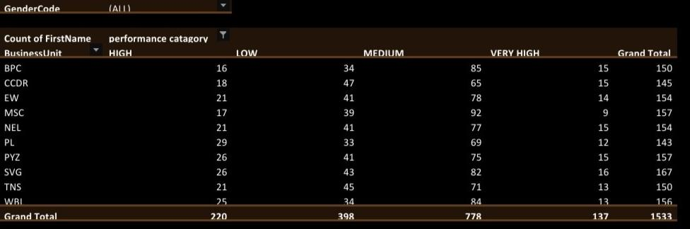
Results:

Slide 13

Conclusion:
Overall, the chart indicates that the distribution of high-performing employees is relatively balanced across the different business units, with no significant outliers. However, further analysis would be required to understand the factors contributing to the variations in performance across these units.
the distribution of employees within different business units (BPC, CCDR, EW, MSC, NEL) who have achieved a high performance rating. The largest segment is represented by the NEL business unit with 29 employees, followed by CCDR with 26 employees. The smallest segment is represented by BPC with 16 employees.Overall

Slide 14


